Slide 1
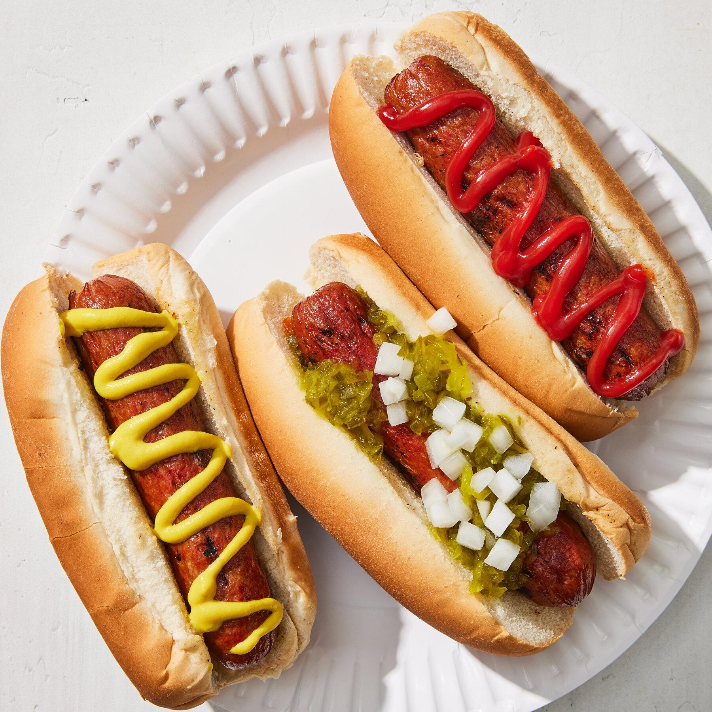
Is a Hotdog a Sandwich?
DS 4002 Project 0

Slide 2


Motivation
The question of whether a hot dog is a sandwich has been debated for years, and we wanted to see what UVA students thought
Literature on this subject had varying opinions so we wanted to see if surveying several students would give a clearer answer

Slide 3


Hypothesis
Less than half of full-time undergraduate students at UVA believe that a hotdog is a sandwich.

Slide 4
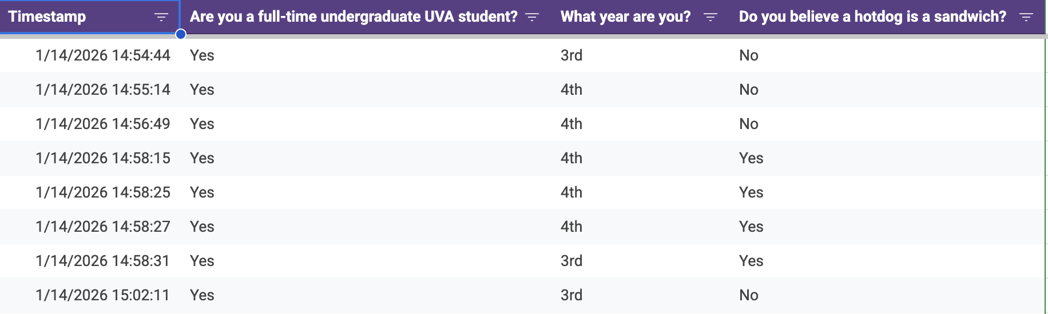
Data
Do you believe a hot dog is a sandwich?
Count of students who responded “Yes”: 13
Count of students who responded “No”: 63
Responses: 79
Full-time students: 76
Year | 1st | 2nd | 3rd | 4th
Count | 0 | 8 | 21 | 47
Google form survey ↓

Slide 5

Analysis Plan
Data cleaning:
Removed rows where respondents were not full-time undergraduate students
Visualizations:
Created various plots and charts in Google Sheets to convey survey results
Built a pie chart to visually show yes vs. no
Created a Pivot Table from the data to show breakdown by student year
Statistical Significance:
Conducted one-tailed z-test to determine if sample proportion had significant difference from null value (0.5)
Also conducted chi-square test to see if the difference in opinions between each student year was significant

Slide 6

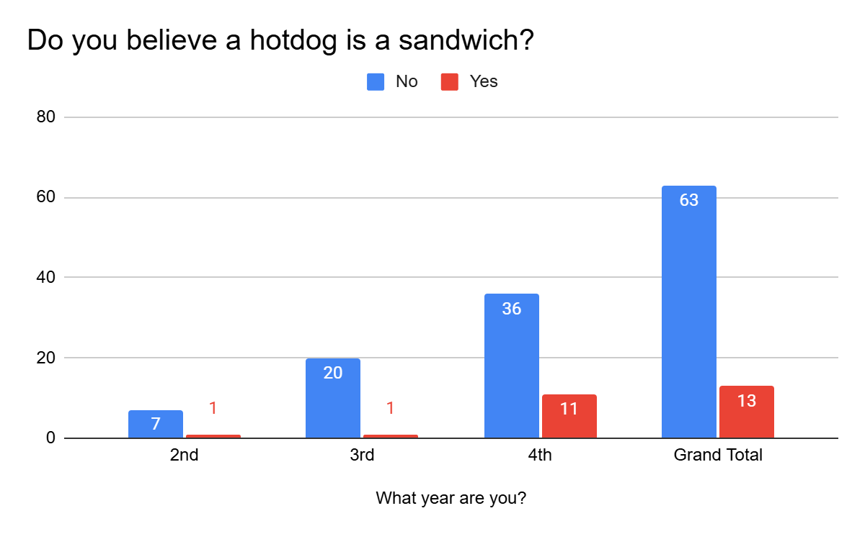
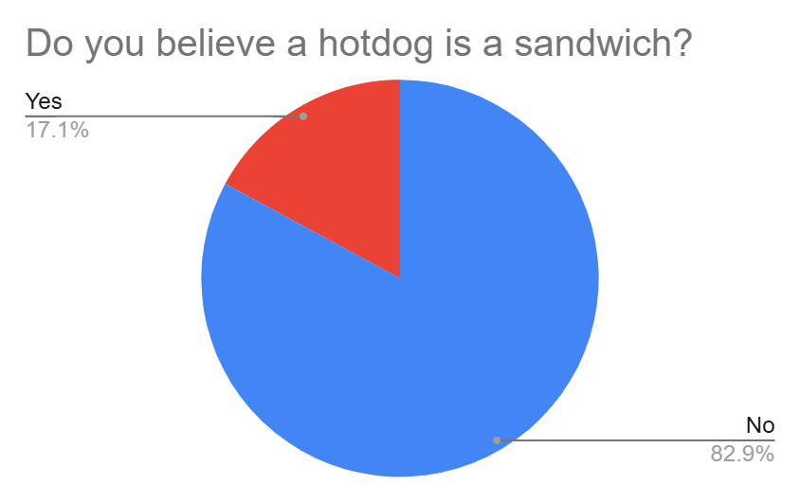
Results/Findings
Z-test: z-statistic of -5.74 and p-value of <0.0001, indicating statistical difference in the sample proportion from null value. Thus, we reject the null hypothesis and our hypothesis is supported.
Chi-square test: Contrary to our visual
observations, we found that the distribution of opinions did not differ significantly between the years

Slide 7

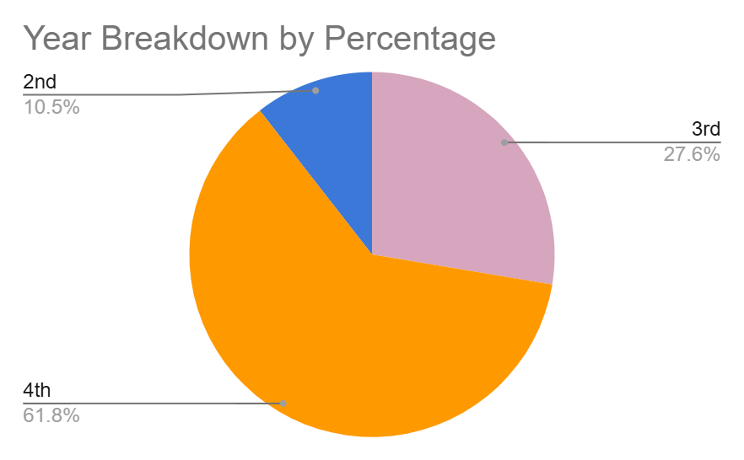
Next Steps
Survey more 1st and 2nd year students. This data is biased towards 3rd and 4th years
Survey by major or school department to make sure all undergraduate students at UVA are represented

